Slide 1
Movie Recommendation
System

Slide 2
Agenda
Introduction
Data Modelling
Data collection
Evaluation
Data Preparation
Conclusion
Data exploration/
analysis

Slide 3
Introduction
Why movie recommendation system ?
Movie recommendation algorithms help individuals find new films based on their interests and watching habits, saving time and effort.
Enhances user engagement and increase the likelihood of continued platform usage, leading to higher revenue from membership fees or advertising for movie streaming services.

Slide 4
Introduction
Specific Questions to address:
Which movie is best rated based on the user reviews?
Which genres are the most popular among the movies in the dataset?
Which users have rated the most movies in the dataset?
Are there any relationships between the age or genders of users and their ratings?
Can we predict the rating a user will give to a movie based on their previous ratings and other factors?
Which movies are most similar to each other based on user ratings?

Slide 5
Data Collection
Movie Lens dataset from Grouplens website
Ratings : 25M
Users : 200,000
Movies : 62,000
Movie Metadata
title
release date
User Ratings
timestamp
user ID
Movie ID
genre

Slide 6
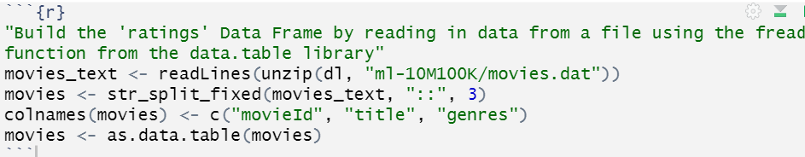
Data Preparation
Building the DataFrame “ Ratings”
The "Ratings" DataFrame is a crucial component of any rating-based dataset analysis or modeling and provides valuable information for understanding user behavior and developing recommendation systems.

Slide 7
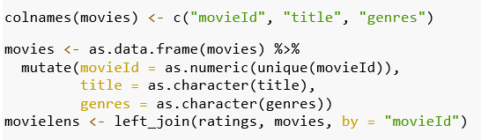
Continued
Merging two datasets
Before undertaking analysis or modeling, combine movie information and user ratings into a single dataset using a common key, such as the movie ID.

Slide 8
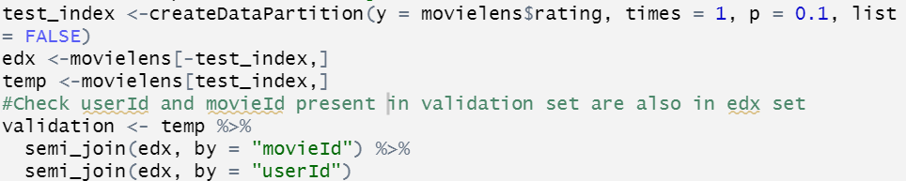
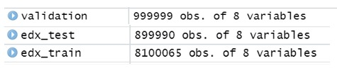
Continued
Partitioning the dataset into training and testing sets.
Make a validation set for model validation by randomly picking 10% of the data. The validation set is cleaned to guarantee that its userId and movieId are present in the training data.

Slide 9
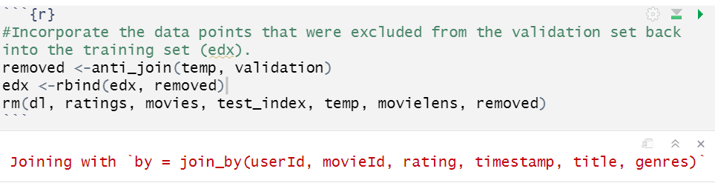
Continued
Adding the rows back
Any rows removed from the validation set are added back to the training set to ensure all data points are retained.

Slide 10
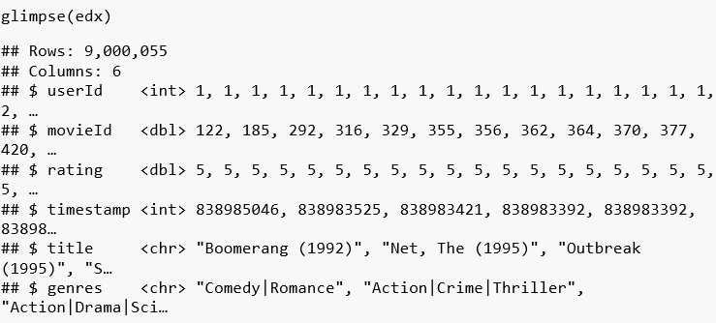
Analyzing the Data
Overview of data

Slide 11
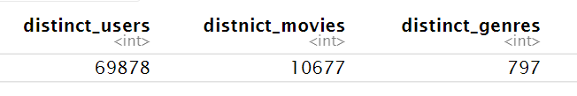
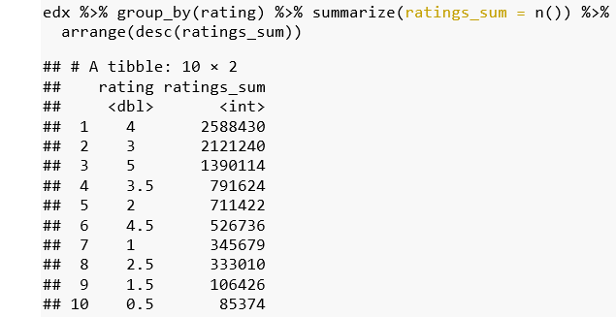
Determining the total number of distinct users, films, and genres in the data.
Showing the number of ratings for each rating level is displayed, along with an analysis of the dataset's rating distribution

Slide 12
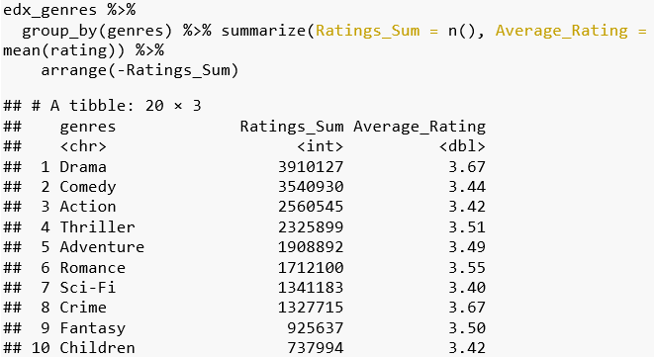
Sum of movie ratings per genre
Grouping the data by genre is useful in determining which movie genres are more well-liked by viewers and have garnered more ratings.

Slide 13
Why treemap?
Simple to compare the overall rating values of various genres
Determines the most well-liked genres and how many ratings each one has earned compares to the others.
Examining the connections between genres and the general rating distribution.

Slide 14
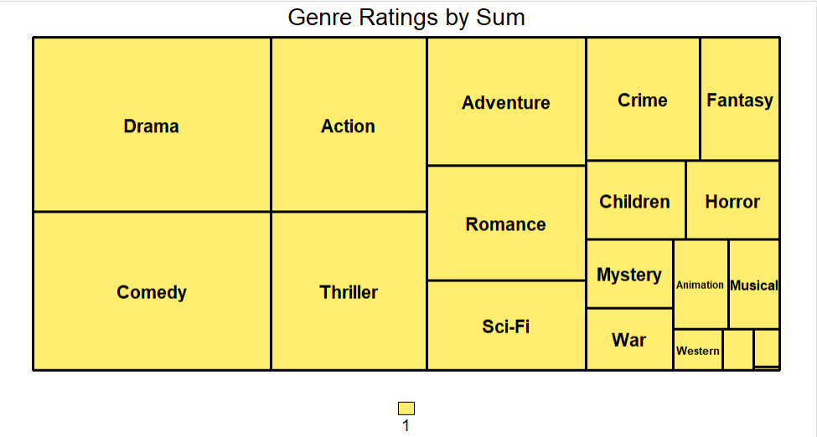
The genre with the most ratings is drama, followed by comedy and action. Based on the ratings added together, the treemap offers a rapid visual comparison of the popularity of various genres.

Slide 15
Why Calculating the total movie ratings per genre?
To get an idea of the general popularity of various genres and how they contrast with one another.
To view trends and patterns in viewers' tastes for movies through time and enables us to comprehend which genres are the most well-liked by audiences depending on the quantity of ratings.

Slide 16
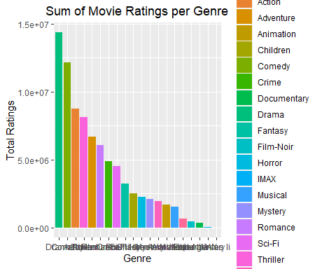
Comparing Sum of Ratings Across Genres
The genres with the highest sum of ratings are Drama, Comedy, Action, Thriller, and Adventure, while the genres with the lowest sum of ratings are Film-Noir, Western, Musical, Documentary, and IMAX.

Slide 17
(Baseline model) Mean rating per year
Examining historical patterns in movie ratings.
It can show if movie ratings have been consistently high or low throughout time, as well as whether there are any trends or swings in ratings that might be connected to certain occasions or adjustments in the movie business.

Slide 18
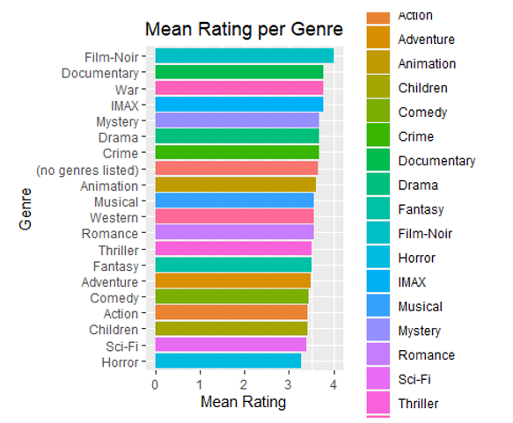
Exploring Trends Over Time

Slide 19
Summary of Exploring Trends Over Time
The greatest mean ratings are for Film-Noir, Documentary, and War, while the lowest mean ratings are for Horror, Sci-Fi, and Children.
There are large differences in the mean scores for various genres, with a range of around 3 to 4.1
Drama, Comedy, and Thriller have lower mean ratings than certain other genres while receiving the most ratings.

Slide 20

Summary of MovieAge
The MovieAge variable in the edx dataset is then given descriptive statistics using the summary() method.
The median age of the films is 26 years, and the mean age is 29.78 years.
The oldest film in the collection was released 105 years ago.
The dataset's newest film is twelve years old.

Slide 21
Data Modelling
Collaborative Filtering Technique
Implementing a matrix factorization model
The Alternating Least Squares (ALS) algorithm which is a collaborative filtering technique would utilize user-provided prior movie ratings to forecast how probable it is that they will rate other movies in the future.
The model is evaluated on the edx_test dataset, which comprises a collection of ratings that were with held from the training set, after having been trained on the edx_train dataset, which contains a set of user-item interactions.

Slide 22




.
Data Modelling
Naïve RMSE : Mean of the edx_train ->
Median Model: Plugging in the median or any other random number will always produce a less desirable RMSE ->
Movie Effects Model: Movie Effects” takes fact that films tend to have different rating distributions
Movie & User Effects Model: “User Effects” reflect the individual users tend to rate films according to their own standards ->
Movie, user & Age Effects model: “Movie Age Effects” incorporate variation among the ratings distribution awarded for films of different ages ->
yu,i = predicted rating, μ = the average rating, bi = the movie effects, bu = the user effects, ba = the movie age effects and ϵu, i = independent errors centered at 0.

Slide 23

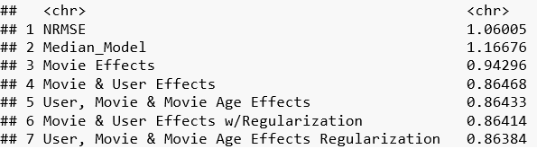
Data Modelling
RMSE/Loss Funtion
We can assess how effectively the recommendation algorithm predicts user ratings and generates reliable recommendations. A lower RMSE suggests more accurate prediction.

Slide 24
Data Modelling
The Non-Personalized Model is the least accurate model with the greatest RMSE.
The Median Model performs better than the Non-Personalized Model but not as well as the models that consider user and/or movie impacts.
Adding movie effects improves the accuracy of the model, while including both user and movie effects further enhances the accuracy.
The most accurate model is obtained by including movie age effects along with user and movie effects. Therefore, the best model for predicting movie ratings includes both user and movie effects as well as movie age effects.

Slide 25
Regularization
Movie & User Effects
Movie, User & Movie Age Effects
It is an extension of the Movie & User Effects Model, which takes into account both the average rating of a movie and the average rating of a user.
The model with regularization is used to prevent overfitting, which is a common problem when fitting models to large datasets.
The model with regularization is trained using a training set and then tested on a validation set.
The regularization parameter is chosen using cross-validation, which involves splitting the training set into several subsets and using each subset as a validation set in turn.

Slide 26
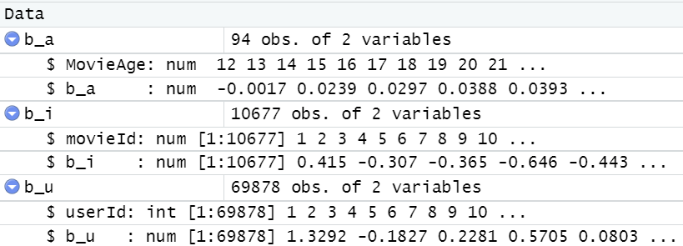
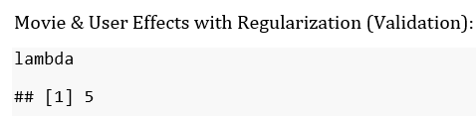
Regularization
Movie & User Effects
The model includes a tuning parameter lambda λ tominimize the RMSE and penalize outliers from bi and bu, which are the movie and user effects, respectively.
The sapply function is used to apply the regularization function.
The lambda value that minimizes the RMSE is determined using the which .min function and saved in the variable lambda.

Slide 27
L2 Regularization
L2 regularization (also called Ridge Regression) by adding an L2 penalty term to the loss function to control the model complexity.
By tuning the regularization parameter lambda, we can find a sweet spot that balances the bias-variance tradeoff and achieves better performance on the test set.

Slide 28
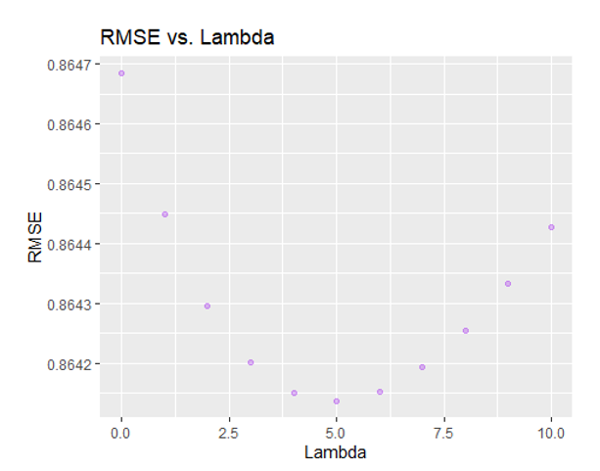

Regularization
Movie & User Effects
  Regularization can help reduce overfitting by penalizing outliers in the model, as evident from the drop in RMSE as lambda rises. Lambda=5
  Why to select optimal lambda value?
    Minimizes RMSE
    Improving model performance while avoiding
    overfitting
Excessive regularization can cause underfitting, leading to an
increase in RMSE.

Slide 29
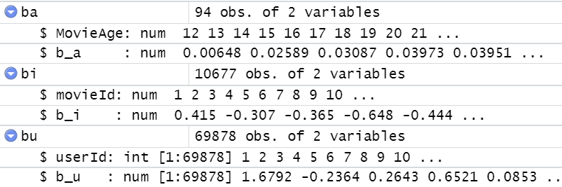
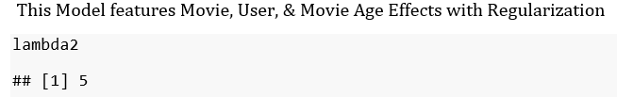
Regularization
Movie, User & Movie Age Effects
  Calculates bias terms for movies, users, and movie age groups and uses them to predict ratings.
  The lambda value that yields the lowest RMSE is selected as the optimal value. In this case, the optimal lambda2 value is 5.

Slide 30
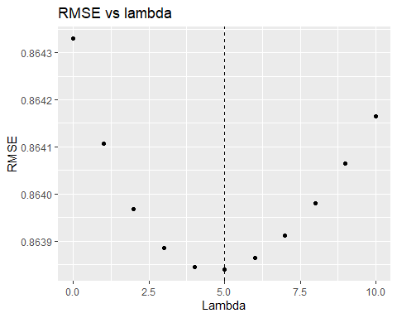
Regularization
Movie, User & Movie Age Effects
Depicts the correlation between the two variables
Curve illustrates how the RMSE varies as lambda
increases
Value of lambda, which results in the lowest RMSE,
is shown by the dashed vertical line

Slide 31
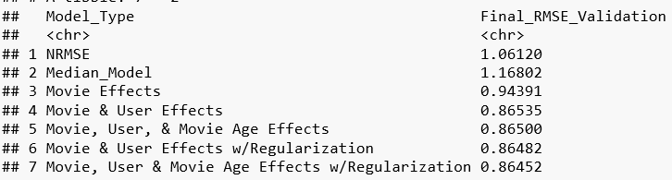
Validation(Evaluating the model)
Training & test set results against those of the validation set.

Slide 32
Validation(Evaluating the model)
.
According to the validation RMSE, the final model—the Movie, User, and Movie Age Effects Model with Regularization—performs the best.
The lowest of all the models assessed, this model's RMSE score is 0.86452.
This indicates that this model's forecasts are the ones that correspond most closely to the actual ratings provided by the users on the validation set

Slide 33
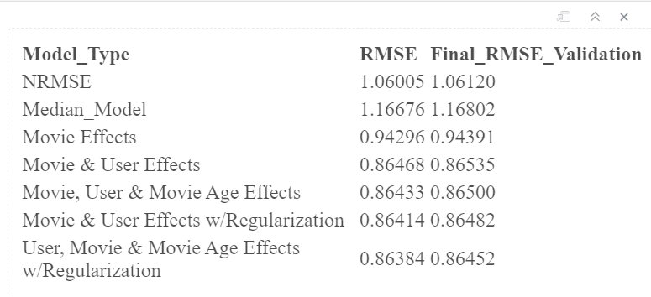
Final Model with Validation
Outcomes of our final model validation for the various models

Slide 34
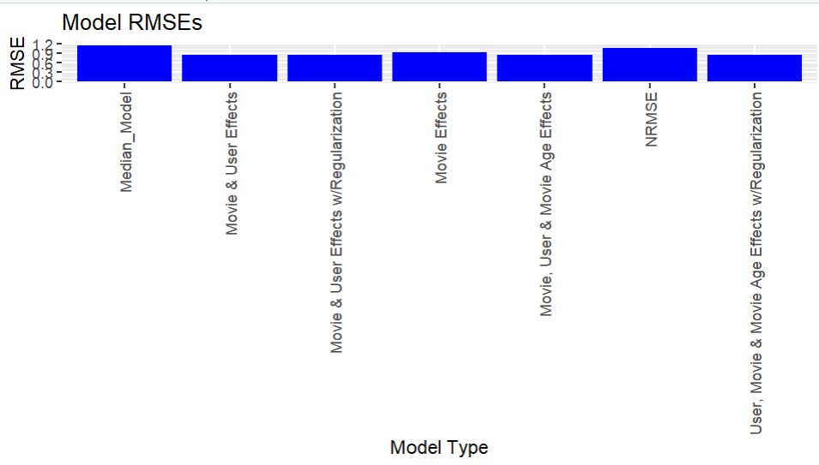
Representation of Model RMSEs

Slide 35
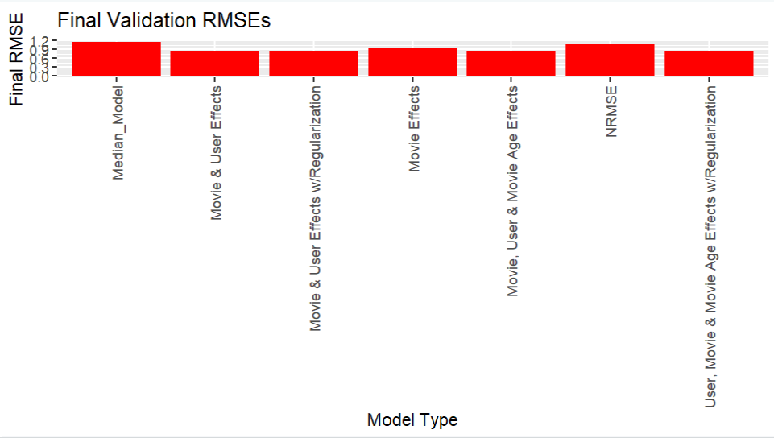
Representation of final Validation RMSEs

Slide 36
Final Model with Validation
Value of 0.86452, the model with User, Movie, and Movie Age Effects with Regularization has the lowest RMSE on the validation set.
As a result, this model is the best model for our objective since it predicts user ratings on unobserved data the most accurately.
This Final Model achieves an RMSE of .86452

Slide 37
Conclusion
Although the final model, which included User, Movie, and Movie Age Effects with Regularization, produced a satisfactory RMSE of 0.86452, it may be worthwhile to investigate additional biases that could enhance the accuracy of the model.
Moreover, using more advanced techniques like Random Forests may offer significant improvements in the RMSE.
Despite achieving an RMSE of .86452, the final model that incorporated User, Movie, and Movie Age Effects with Regularization could benefit from exploring other biases to further enhance its accuracy.

